Slide 1
WiFi Booster Impact
SB:
Typos!
What must be answered for C-level:
Does it worth his time?
Is it on a good track?
Presentation:
For 10 min slot: 5min slides + 5 min Q&A
1 slide – executive summary (key result / actionables )
2-3 slides – set the stage (must be easy to follow)
1 slide – “Aha!“ slide (key message / finding), here spend time for discussion and next steps
Appendix – all other slides for deep dives / offline reading
Juniora Nalyst
15.05.2026

Slide 2
EDA

Slide 3
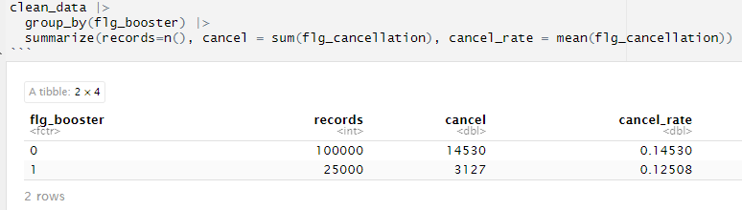
SB: put it in a proper table

Slide 4
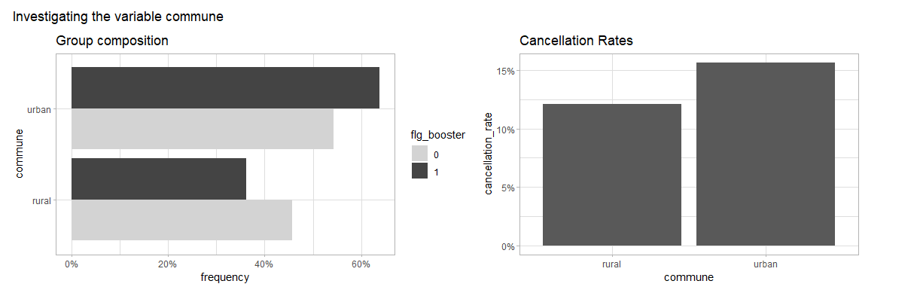


SB: in general – try to reduce reader‘s cognitive load where possible
1) use words add proper names instead of variables and flags
2) Orient graph in same way, unless needed to tell the story (across presentations)
3) Keep order of categories the same (across presentations)

Slide 5
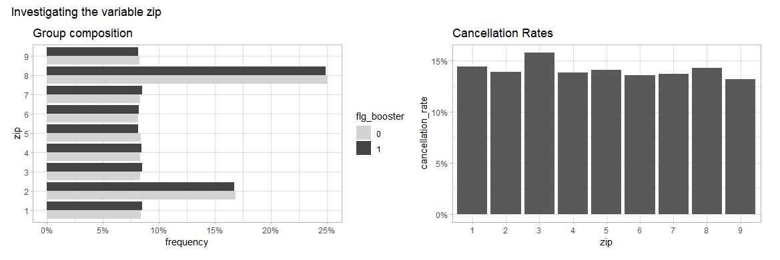


Slide 6
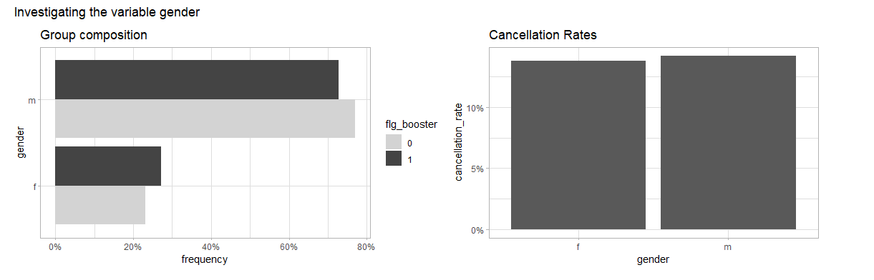

Slide 7
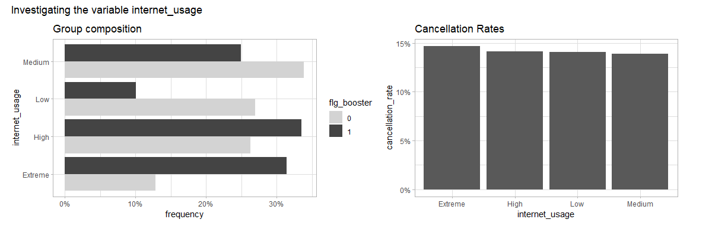

Slide 8
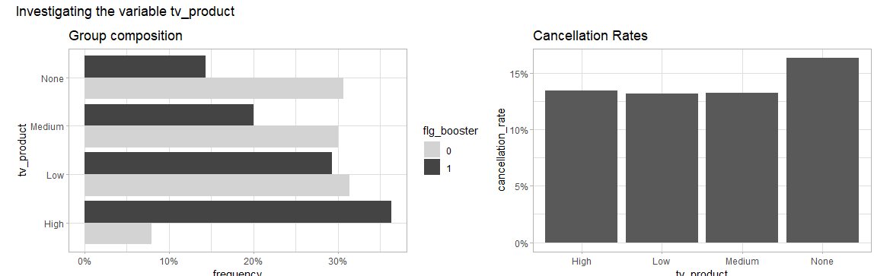

Slide 9
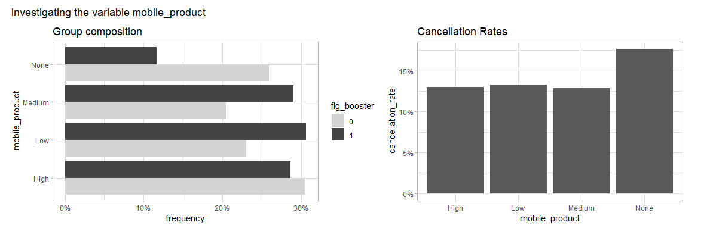

Slide 10
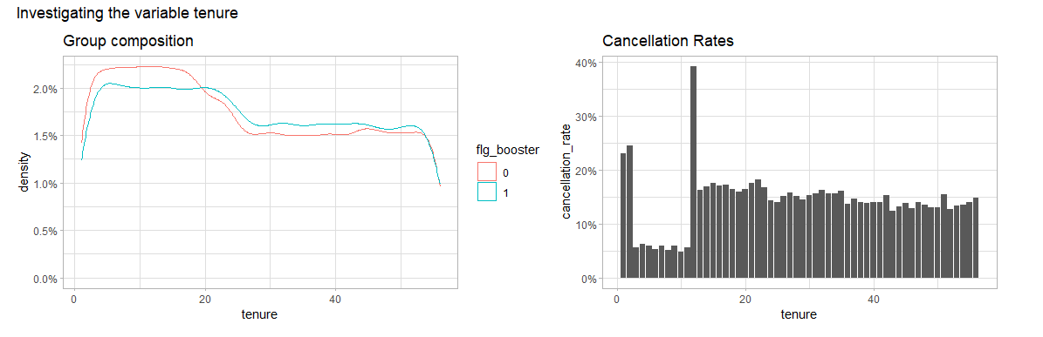


SB: 1) densities are low, hence are potential spikes / jagged lines.
2) Business doesn‘t have special treatment for month 9 of tennure, month 11, etc
Better use cohorts (agree with business)

Slide 11
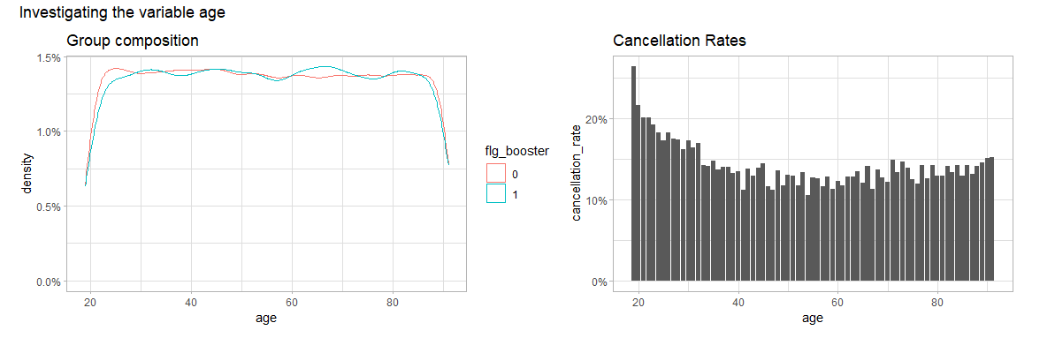
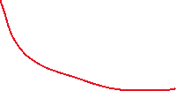

Slide 12
Impact

Slide 13
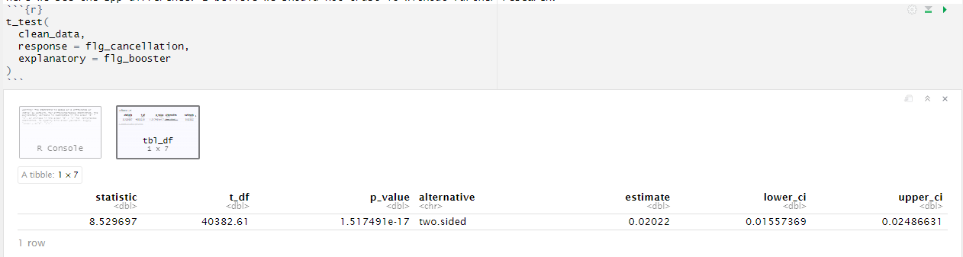

t-test on cancellation
SB: strictly speaking t-test is not for binary variables,
but varibles satisfy CLT, so its effectively a z-test
SB: the issue is +2pp of the booster (booster causes churn,
also contradicts logistic regression),
probably due to confounders.

Slide 14
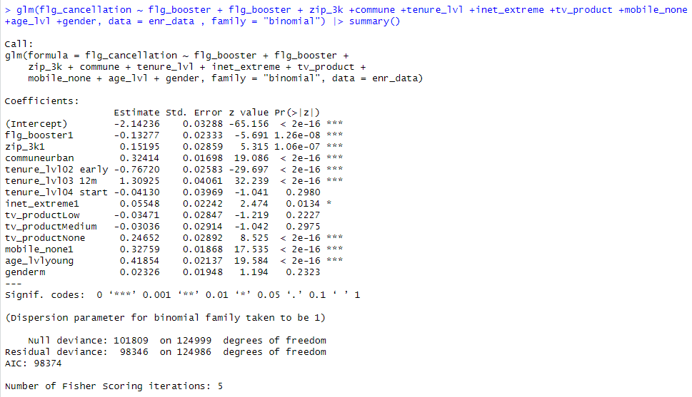
Logistic Regression
14.5% * (1-0.13277) = 12.5748%
SB:
0.13277 are logodds, not probability. If use, then: 1-exp(−0.13277)= 1-0.8757 = 12,4%
Better don’t use as
model is non linear, i.e. changing coefficient by 0.5 doens’t produce constant probability change (depends on baseline)
Concept of logodds is not trivial (unnecessary cognitive load)

Slide 15
Business Case
Assumptions
Customer Base: 1,500,000
Cancellation rate: 14.5%
Value of 1 less cancel: 100 * 18 = 1,800
Cost of 1 Booster: 35
Calculation:
‘No booster’ cancellations: 1,500,000 * 14.5% = 217,500
‘Give booster’ cancellations: 1,500,000 * 12.5% = 187,500
(+) 217,500 - 187,500 = 30,000 * 1,800 = 54,000,000
(-) 1,500,000 * 35 = 45,000,000
9,000,000 net benefit !!
SB: there is a selection bias, lower churn rate is
not applicable to population

Slide 16
NEXT STEPS
Recommendations
ideally more research is needed before decision
could do a causal analysis, for example
if decision needed immediately, full rollout seems worth CHF 9 million basedo n t-test and log reg both saying 2% less churn with Wi-Fi booster
SB:
Short-term
options (depends on context, which I don‘t know):
Optimal: give it 2 more days and if more research is still needed reschedule the meeting (1 week)
Suboptimal:
do propper EDA – if there are actionable findings, then present it and agree on follow up
do it myself/together (if it’s all hands / blocker for other teams / context requires it)
Long-term
Fix process:
Scrum-master cannot assign this properly,
Checkpoints (2 weeks) are too rare for Junior level,
“Write analytical design” (peer-reviewed) must be first task/US in sprint
Action points for JDA:
Assess personality treats (e.g. HEXACO, Motivation)
Build skills map,
Build development plan (together)

